Slide 1

Resolve IT Smart Grievance and Feedback Management System
Name: R.S.DIKSHA

Slide 2
Resolve IT Smart Grievance and Feedback Management System
PROCESS ONE: USER REGISTRATION AND LOGIN SYSTEM
PROCESS two: GRIEVANCES SELECTION AND SUBMISSION
PROCESS three: Complaint submission page
PROCESS four: Complaint transfer to respective departments
PROCESS five: RESOLVING THE COMPLAINT
PROCESS six: COLLECTING FEEDBACK

Slide 3
PROBLEM STATEMENT
KEY ISSUES THAT LEAD TO THE PROJECT DESIGN
Grievances and feedback management features are often overlooked in many commercial websites, resulting in poor handling of customer issues and service dissatisfaction. For machinery purchases in particular, customers frequently face problems or require support, yet there is no dedicated platform to report issues, track resolutions, or share feedback. This lack of a structured system creates delays, confusion, and loss of trust.

Slide 4
OBJECTIVE
THE OBJECTIVE OF THE PROJECT
A dedicated grievances and feedback management system for machinery buyers becomes essential to ensure timely support, transparent communication, and improved customer experience. Building a Smart Grievances System for a Company that works on Machineries for various Offices, Vehicles, Homes and Industries are quite challenging to manage where a feedback system would help it be more organized.

Slide 5
Feature Document
Feature No. | Feature | Description | Status | Further Plans
1 | User Login | Permits the user to login into their dashboard | Completed | Verification through bill id
2 | Admin Login | Allows the Admin to login into the dashboard | Completed | Creating a crew login page
3 | User Dashboard | The User can view their history and register complaints in this page | Completed | Making the page completely functional
4 | Profile and Logout Page | The user can view their profile details and logout | Completed | Adding and editing profile details
5 | Admin Dashboard | Admin views and allocates to departments | In Progress | Making a working page

Slide 6

TOOLS AND TECH STACK USED IN PROJECT
LANGUAGES IN FRONTEND :
Html, CSS, JAVASCRIPT
BACKEND:
JAVA SPRINGBOOT
For designing:
ADOBE EXPRESS
FOR UI/UX DESIGN:
CANVA, FIGMA, ADOBE EXPRESS
DATABASE:
MySQL
REPOSITORY:
GIT AND GITHUB

Slide 7
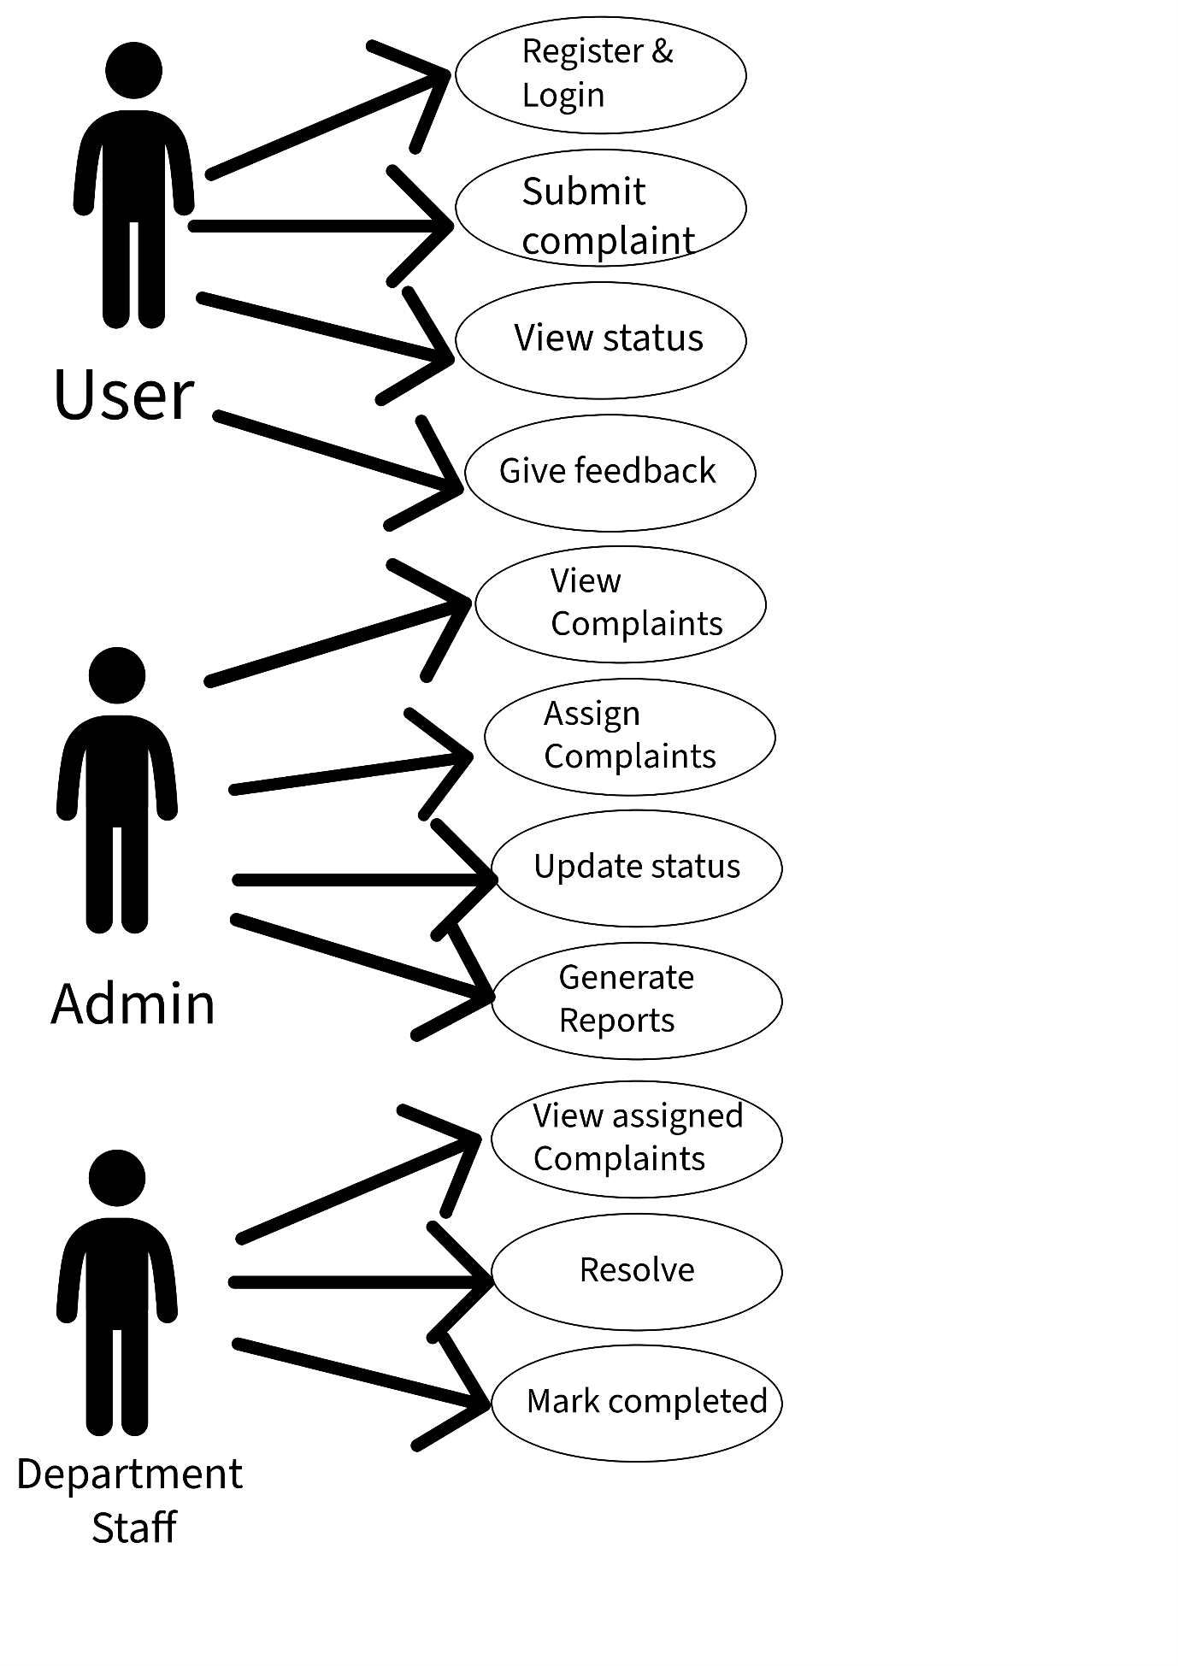
USE CASE DIAGRAM WITH 3 ACTORS

Slide 8
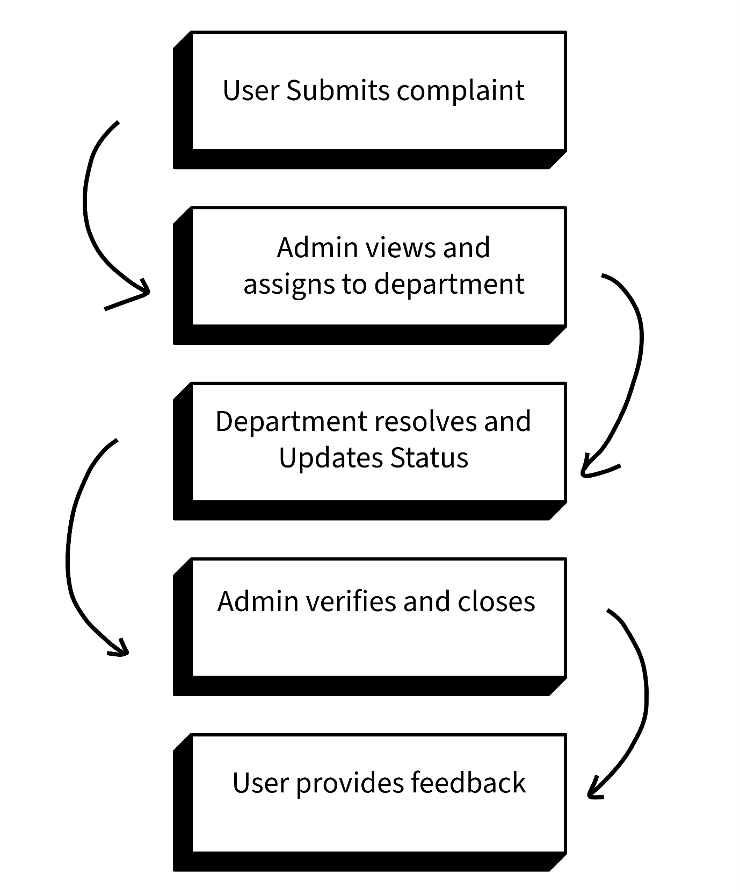
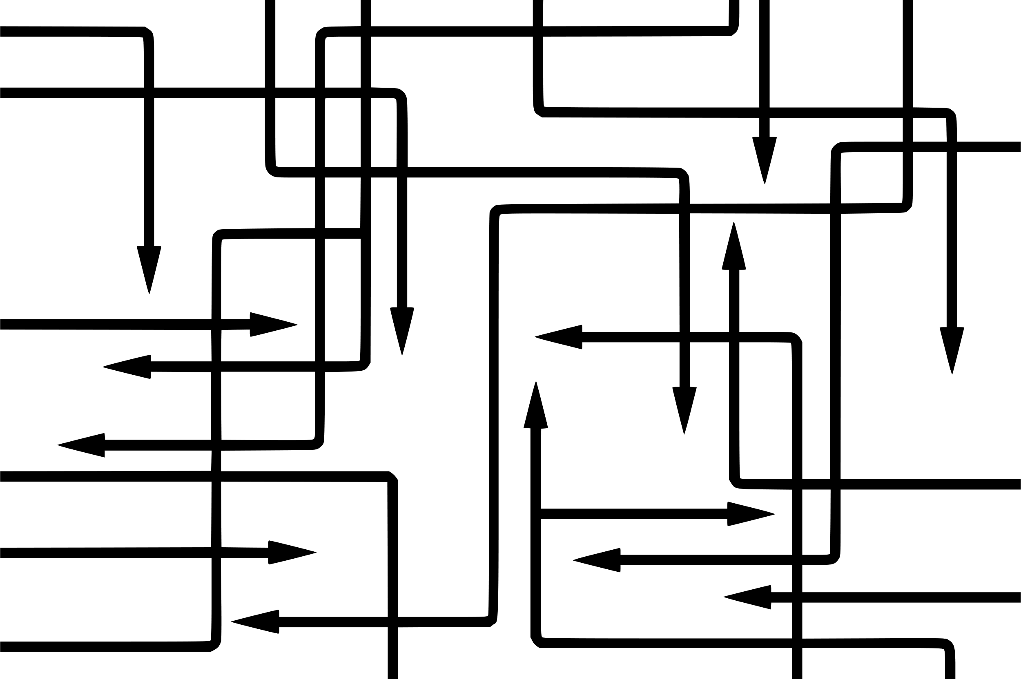
WORK FLOW DIAGRAM

Slide 9
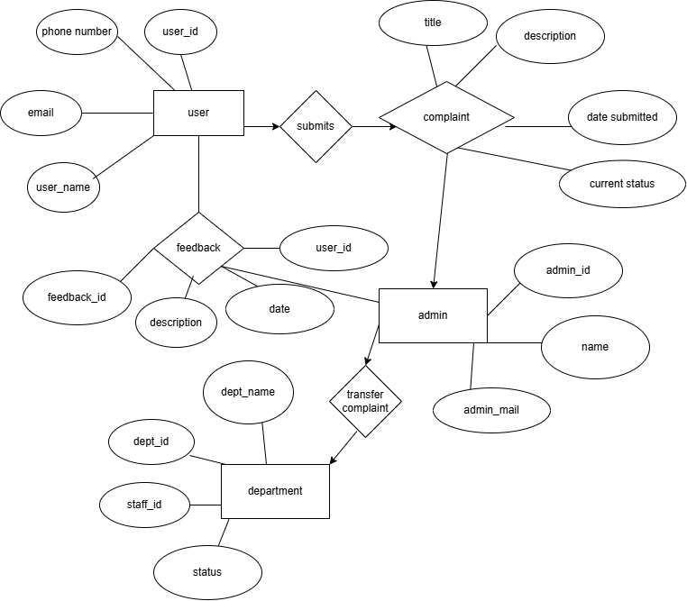
ER DIAGRAM DIAGRAM

Slide 10
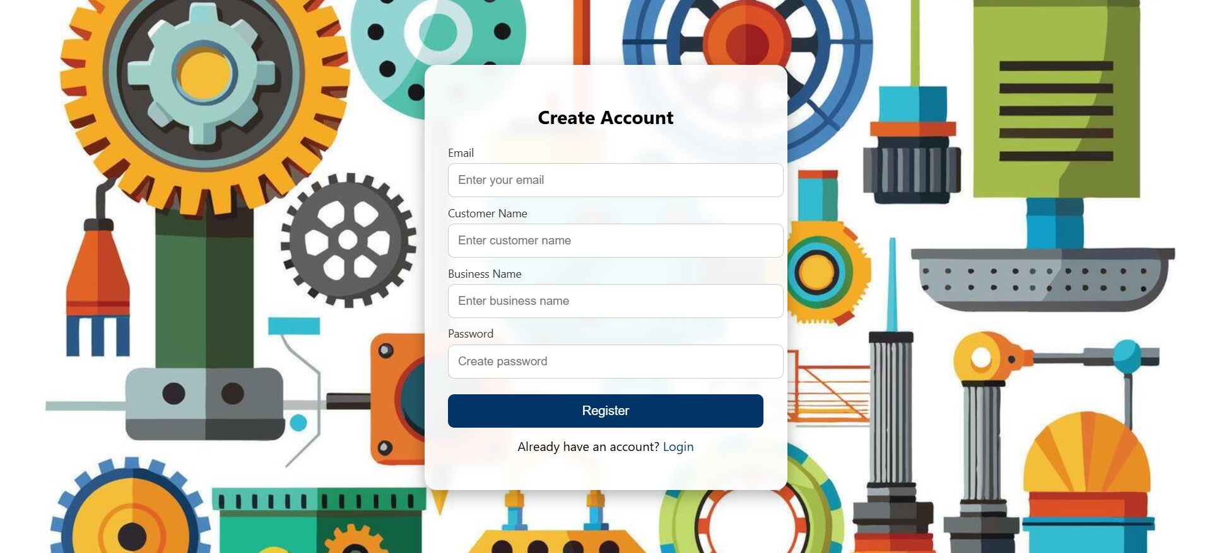
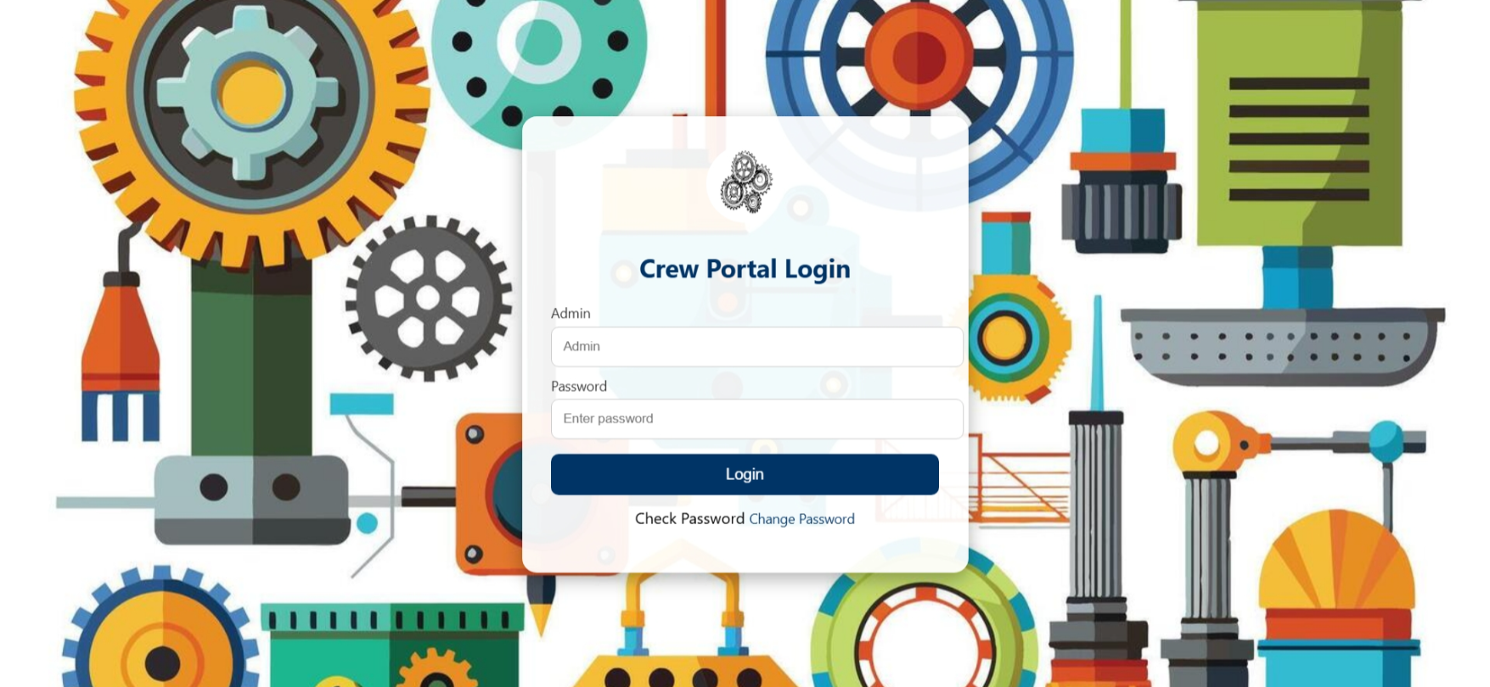
UI/UX DESIGNS

Slide 11
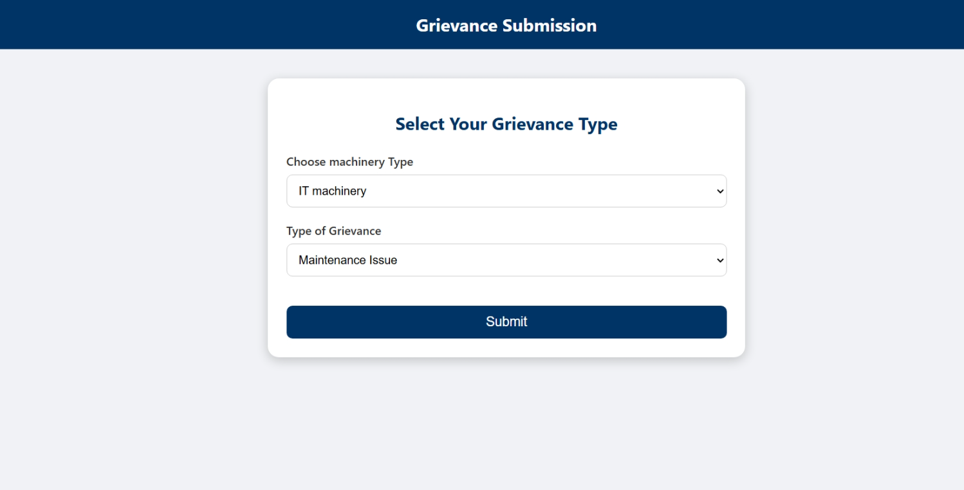
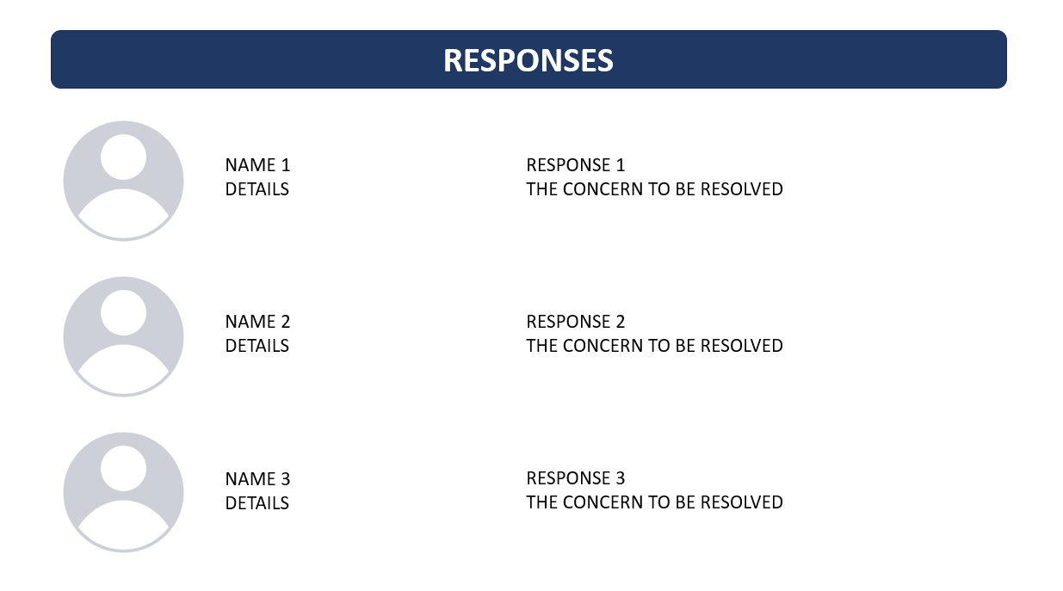
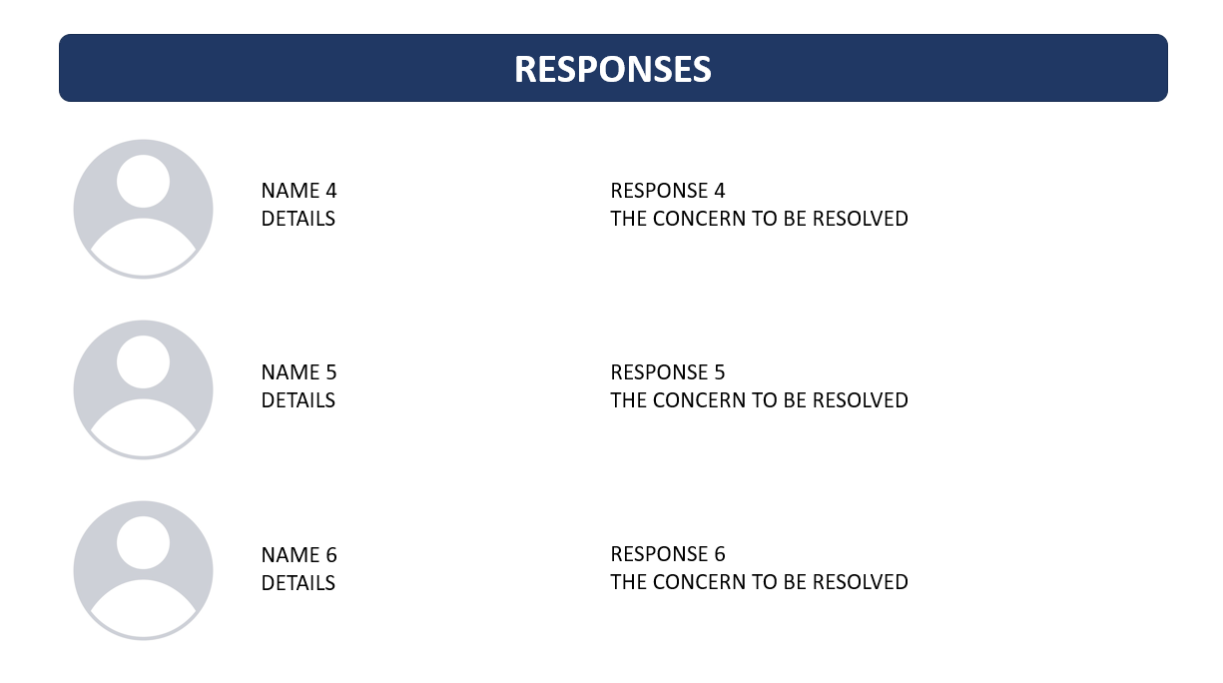
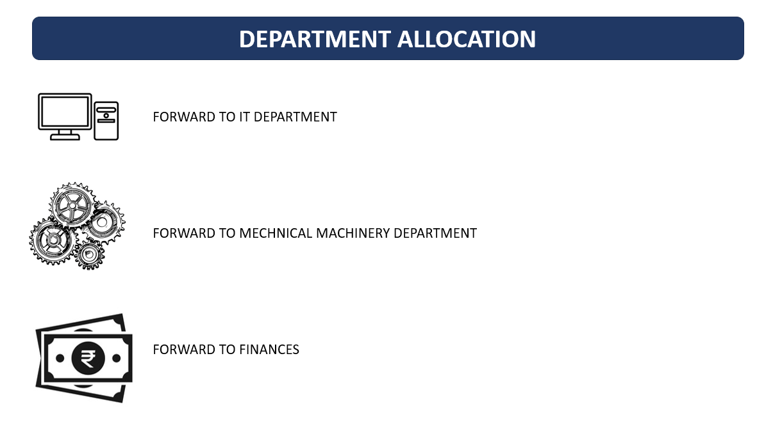

Slide 12
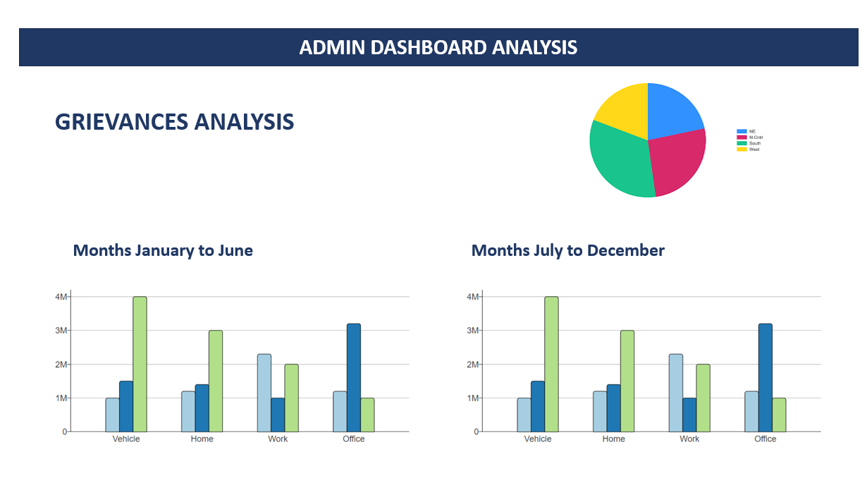

Slide 13
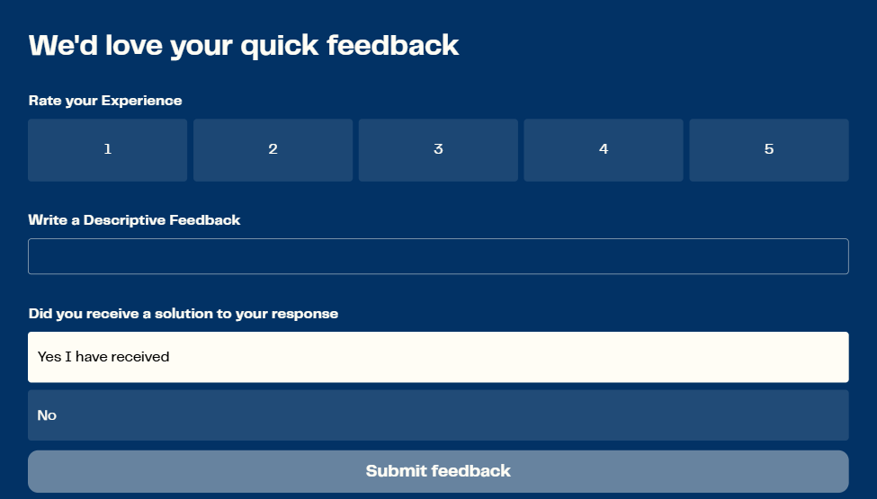

Slide 14
Sprint Analysis and Requirements
USER LOGIN
When the email and password are entered takes the user to the user dashboard
ADMIN LOGIN
For the admin login page where it takes the admin to an admin dashboard where the department allocations are proceeded with
USER DASHBOARD
The user dashboard is the page where the user interface and user experience design must be taken into at most consideration to make the process a cakewalk for the user
PROFILE PAGE
Shows the user details with read only options not editable currently the ability to edit will be added in future sprint
LOGOUT PAGE
Shows that the user has logged out also redirects to the login page when the user intends to login
ADMIN DASHBOARD
The admin dashboard allows the admin to view complaints as well as forward the grievances to the respected departments and view the feedback

Slide 15
The tasks for the Sprint 2 coming up
A fully functional admin dashboard
Page for selecting the type of grievances
Submit page for feedback and complaints
Staff login page and complaint management system
Backend integration for working
Database using mysql for storing their details and information

Slide 16

Frontend Screenshots

Slide 17
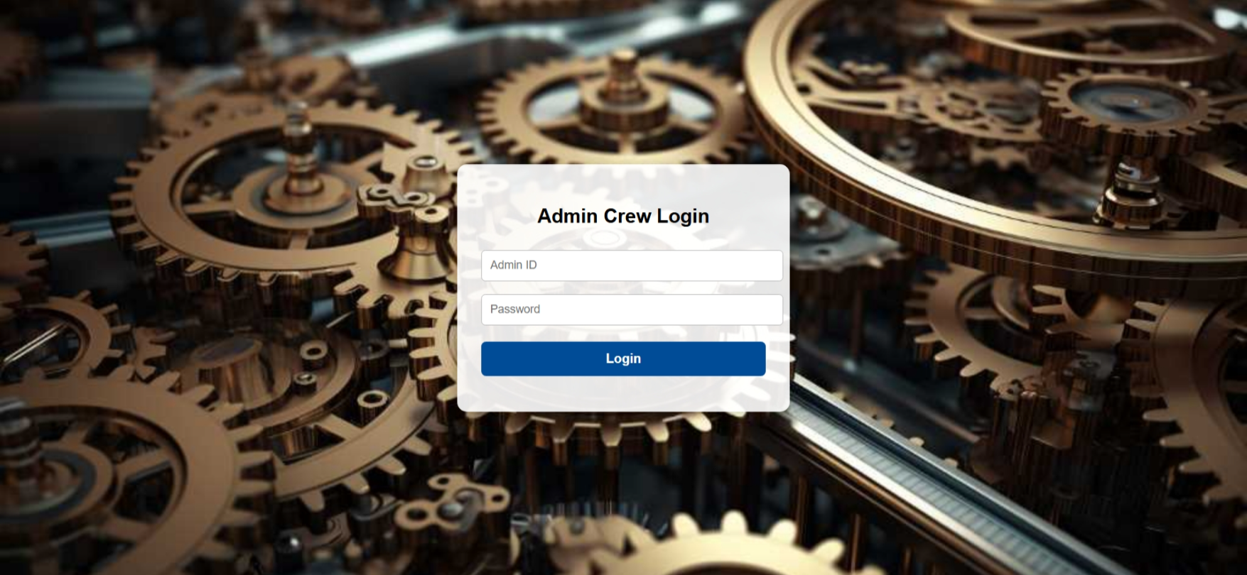

Slide 18
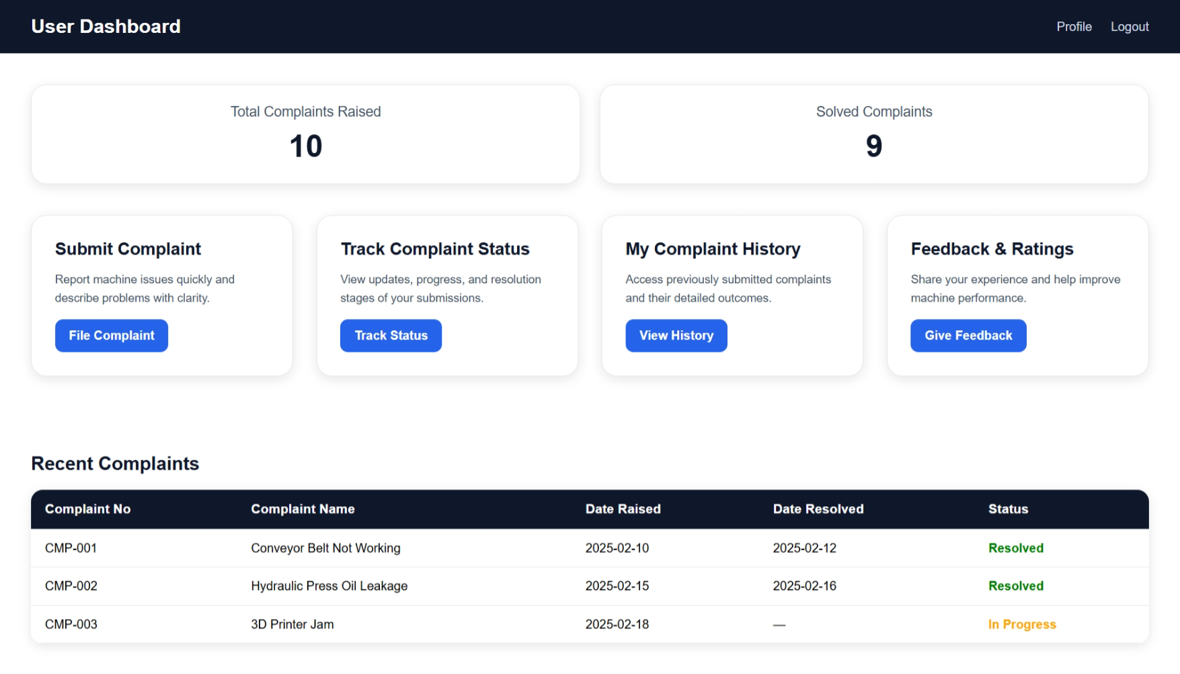

Slide 19
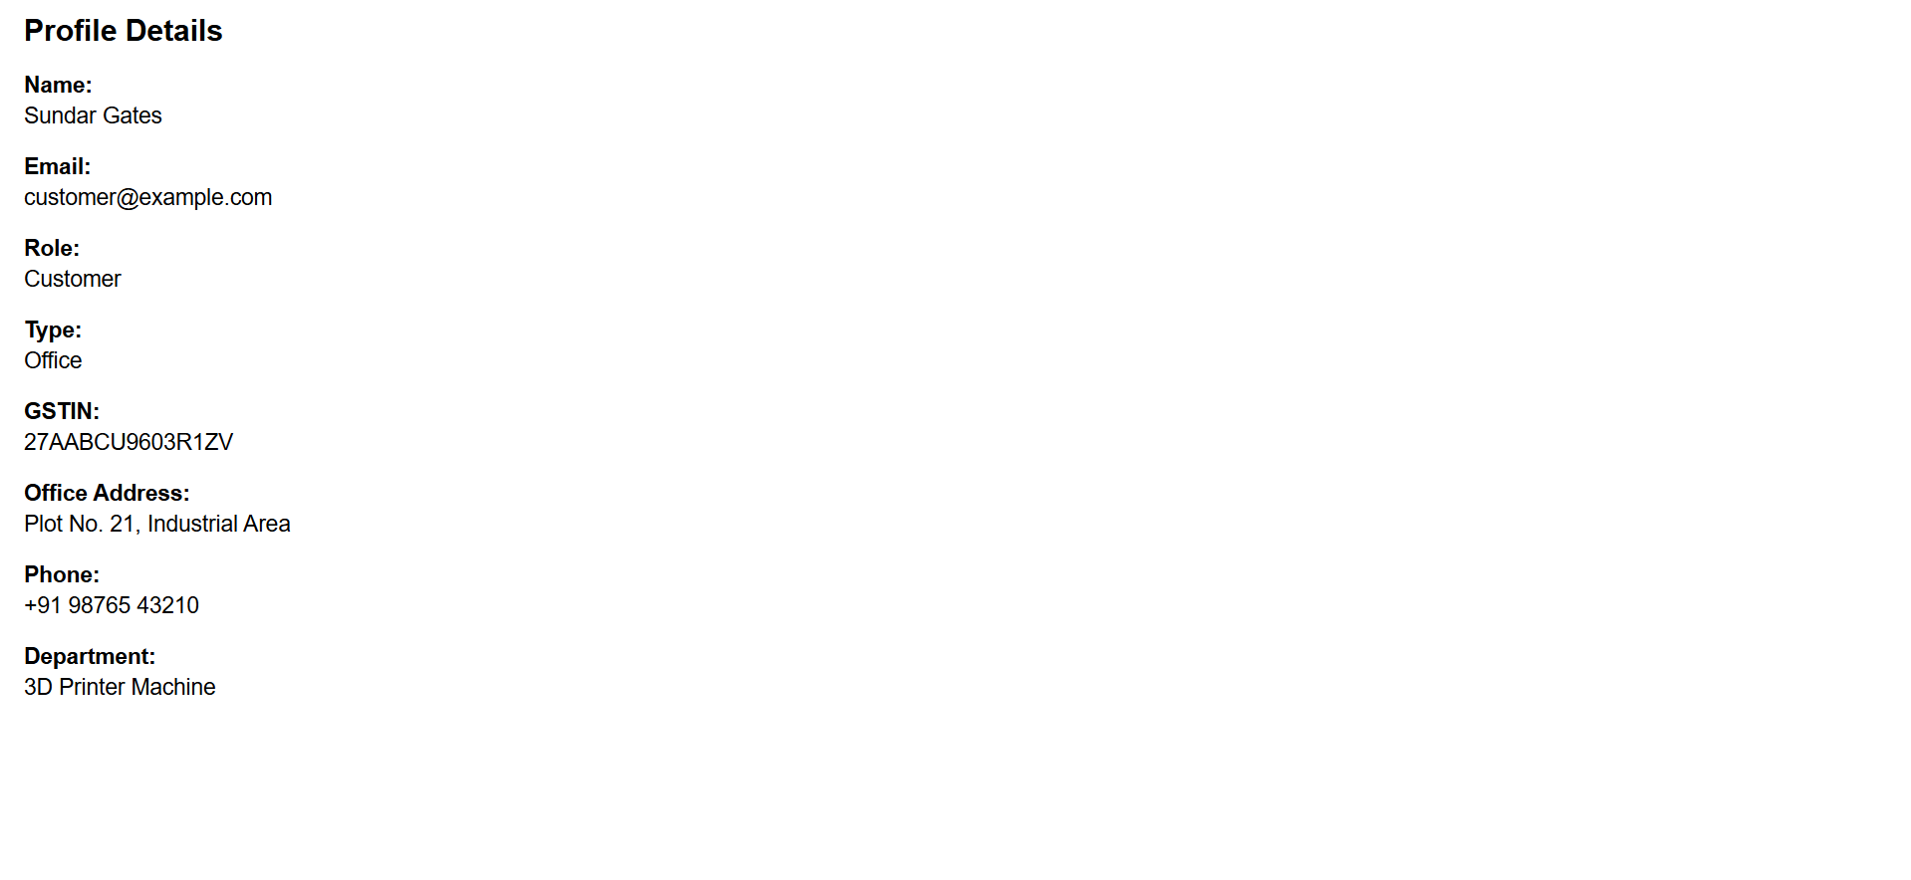
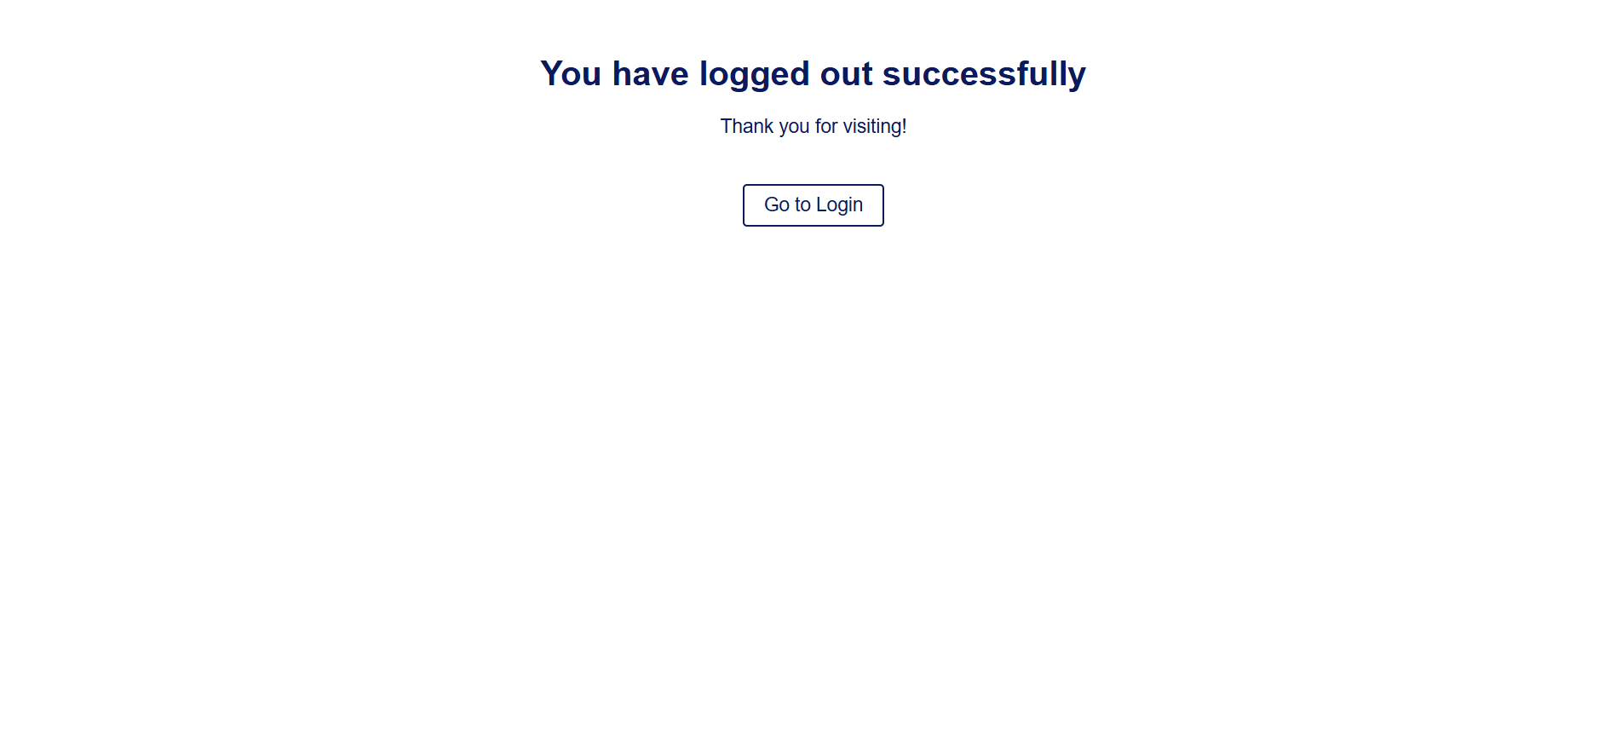

Slide 20
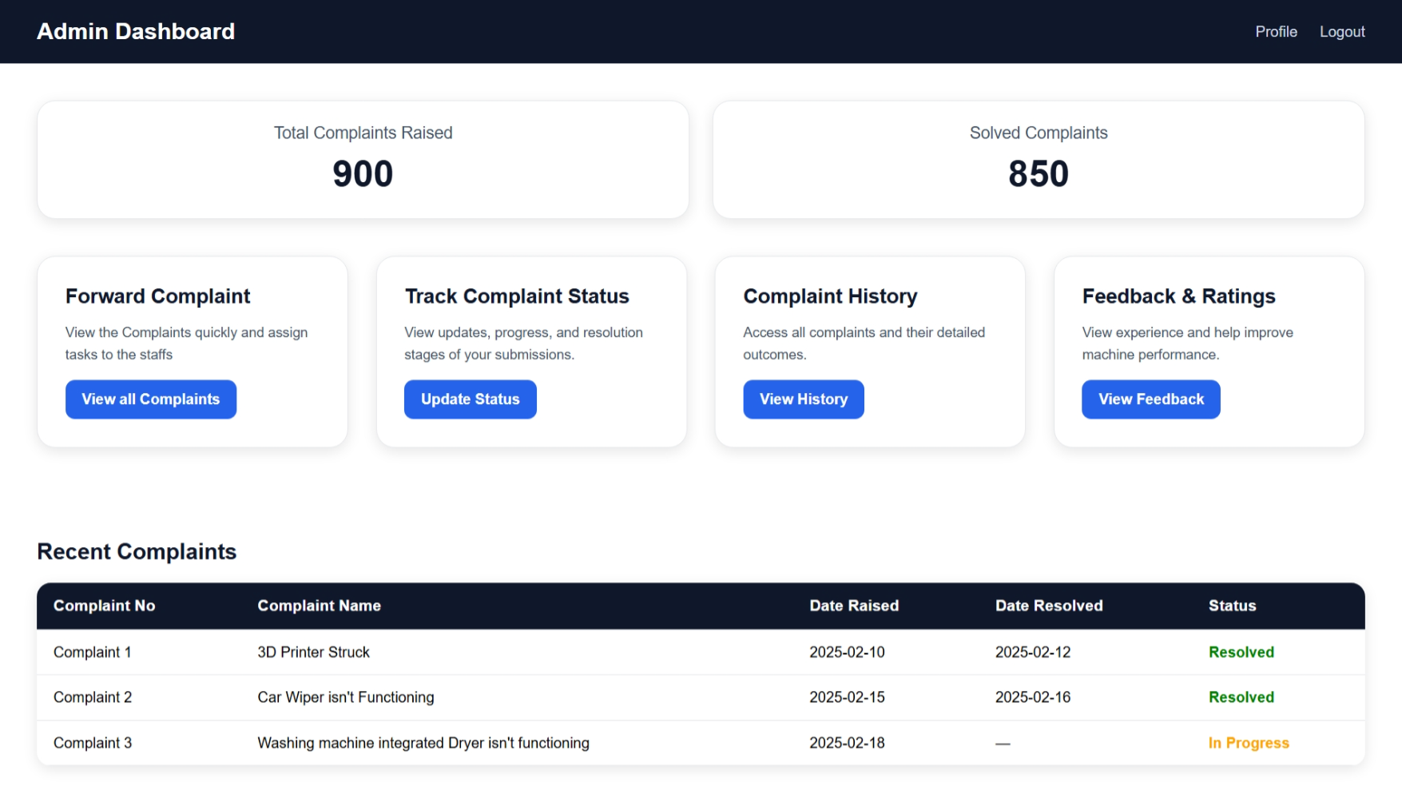

Slide 21
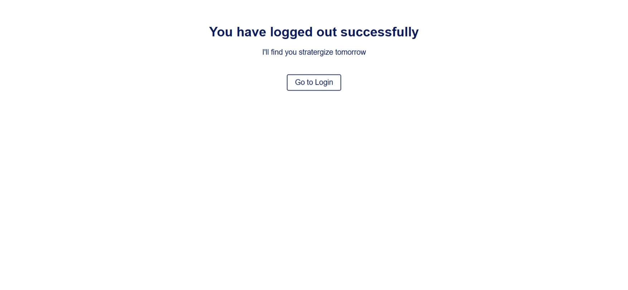

Slide 22





Advantages
MONEY
PEOPLE
DATA
TIME EFFECTIVE
EFFORTS
SINCE THE COMMUNICATION IS DONE ONLINE THE CUSTOMER DOESN’T HAVE TO MAKE CALLS OR VISIT THE COMPANY FREQUENTLY SAVING THEIR MONEY.
THE DATA GETS STORED PERMANENTLY AND CAN BE VIEWED AT ANYTIME FROM ANYWHERE BY BOTH CUSTOMERS AND THE OWNER
THE CUSTOMER SATISFACTION AND TRUST OF THE COMPANIES AND DEALERS ARE TAKEN CARE OF BY TIMELY SOLUTIONS
DEMANDS MINIMAL EFFORTS FROM BOTH THE PARTIES AS IT IS COMPLETELY ONLINE WEBSITE BASED SERVICE
SAVES THE TIME OF CUSTOMER AND USER MAINTAINING LOYALTY AMONGST CUSTOMERS

Slide 23
FUTURE ENHANCEMENTS
2
AI BASED CATEGORIZATION
1
chatbot
3
ai based segregation
4
AUTOMATIC ALLOCATION OF TECHNICIANS
6
VOICE BASED FEEDBACK AND RESPONSE DETECTION
5
LOCATION TRACKING OF TECHNICIANS

Slide 24
DAY WISE WORK
UNDERSTANDING THE ISSUE AND FEATURES
USER DASHBOARD
DAY 12
TABLES AND
ER DIAGRAM
DAY 5
TOPIC SPECIFIC UI/UX PAGES
DAY 8 & 9
DAY 1 - 3
LOGOUT PAGE AND PROFILE PAGE
DAY 13 & 14
USE CASE AND WORKFLOW DIAGRAM
DAY 4
UI/UX DESIGN FOR PAGES
DAY 6 & 7
LOGIN PAGES FOR ADMIN & USER
DAY 10 & 11

Slide 25
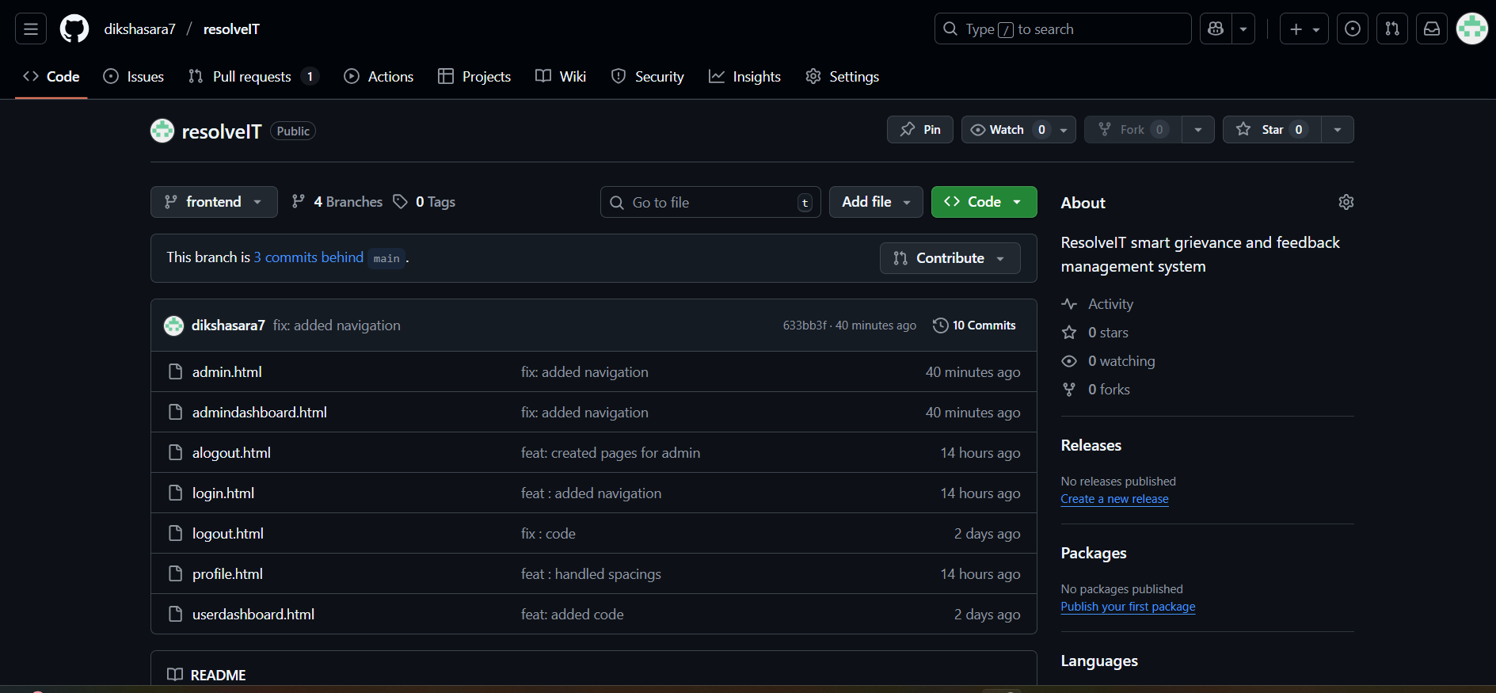
Git and GitHub

Slide 26
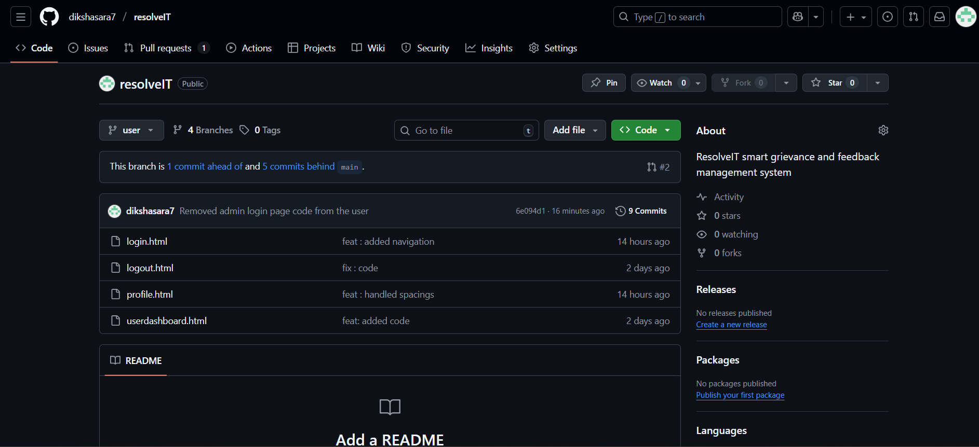
User Branch

Slide 27
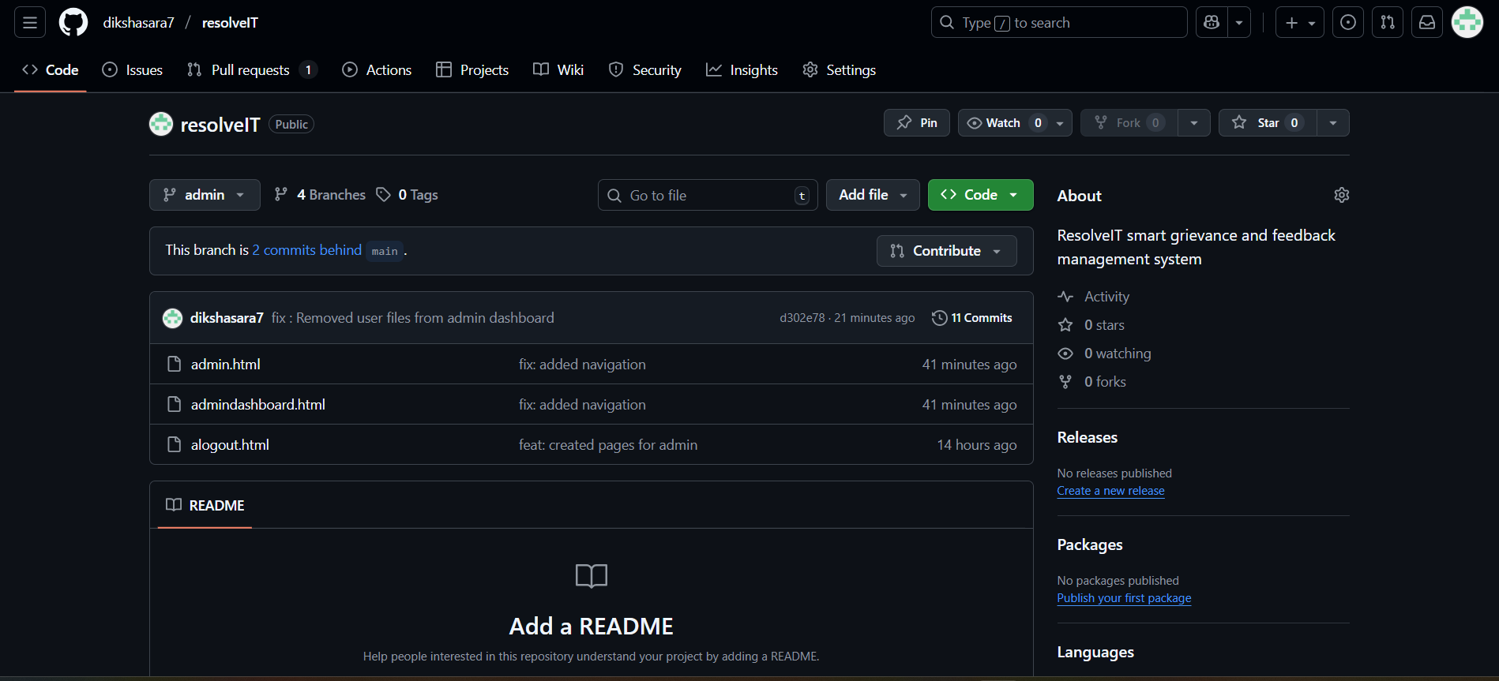
Admin Branch

Slide 28
THANK YOU

